Slide 1
Inheritance

Slide 2
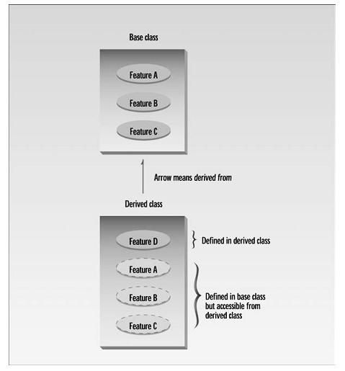
Inheritance
Inheritance is probably the most powerful feature of object-oriented programming, after classes themselves.
Inheritance is the process of creating new classes, called derived classes, from existing or base classes.
The derived class inherits all the capabilities of the base class but can add extra functionality of its own.
The base class is unchanged by this process.

Slide 3
Benefit of Inheritance
Code Reusability
ease of distributing class libraries
A programmer can use a class created by another person or company, and, without modifying it, derive other classes from it that are suited to particular situations.

Slide 4
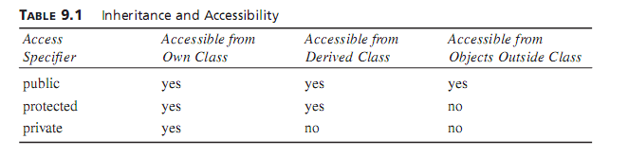
protected

Slide 5
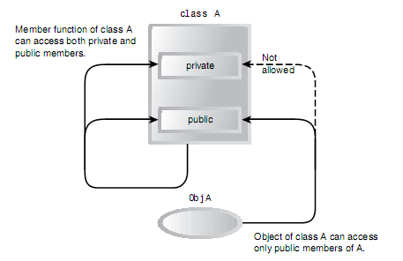
Access specifiers without inheritance

Slide 6
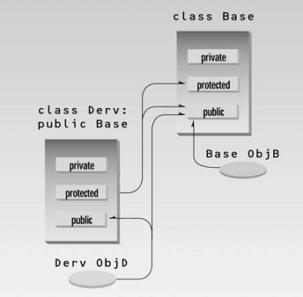
Access specifiers with inheritance

Slide 7
Syntax
Creating a derived class
class Derived : public Base

Slide 8
Overriding member functions
We can override the base class functions, i.e. make the functions in derived class with the same name as in base class.
Useful when we wish to give new meanings to those functions.
How does the compiler know which function to call?
Rule is “When the same function exists in both the base class and the derived class, the function in the derived class will be executed”.
Parent function still can be used in the derived class by usnig scope resolution operator ::

Slide 9
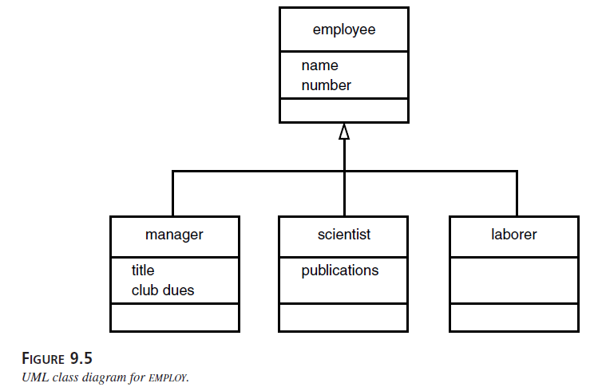
Class diagram showing inheritance

Slide 10
class employee & manager
class employee {
private:
char name[LEN];
unsigned long number;
public:
void getinput() {
cout << “\n Enter last name: “; cin >> name;
cout << “ Enter number: “; cin >> number;
}
void showdata() const {
cout << “\n Name: “ << name;
cout << “\n Number: “ << number;
}
};
class manager : public employee {
private:
char title[LEN]; //”VP”
double dues; //golf club dues
public:
void getinput() {
employee::getinput();
cout << “ Enter title: “;
cin >> title;
cout<<“ Enter golf club dues:“;
cin >> dues;
}
void showdata() const {
employee::showdata();
cout << “\n Title: “ << title;
cout<<“Golf club dues: “<< dues;
}
};

Slide 11
class employee & scientist
class employee {
private:
char name[LEN];
unsigned long number;
public:
void getinput() {
cout << “\n Enter last name: “; cin >> name;
cout << “ Enter number: “; cin >> number;
}
void showdata() const {
cout << “\n Name: “ << name;
cout << “\n Number: “ << number;
}
};
class scientist : public employee
{
private:
int pubs;
public:
void getinput() {
employee::getinput();
cout<<“Enter number of pubs:“;
cin >> pubs;
}
void showdata() const {
employee::showdata();
cout << “\n Number of publications: “ << pubs;
}
};

Slide 12
class employee & laborer
class employee {
private:
char name[LEN];
unsigned long number;
public:
void getinput() {
cout << “\n Enter last name: “; cin >> name;
cout << “ Enter number: “; cin >> number;
}
void showdata() const {
cout << “\n Name: “ << name;
cout << “\n Number: “ << number;
}
};
class laborer : public employee {
}

Slide 13
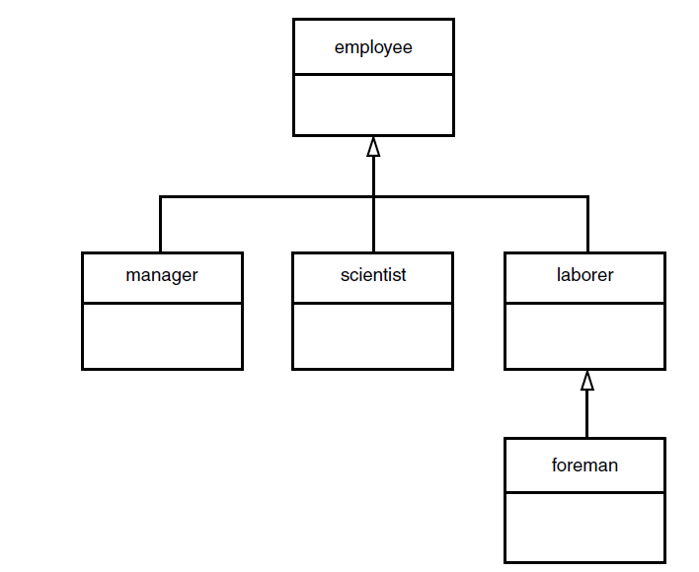
Multi level inheritance
Classes can be derived from classes that are themselves derived

Slide 14
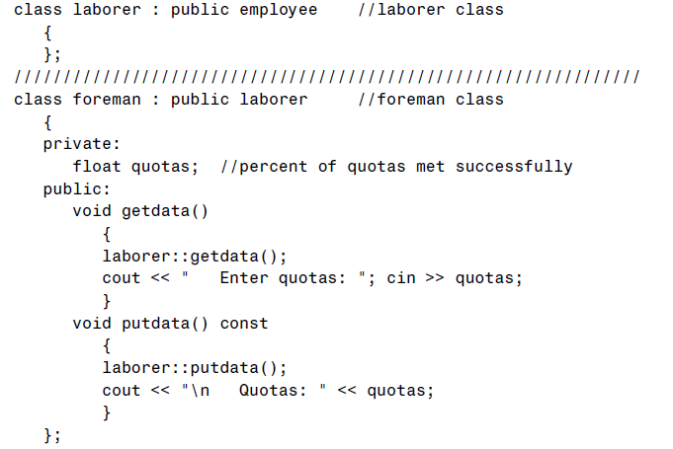

Slide 15
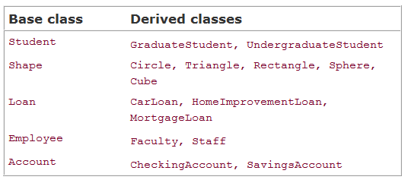
Inheritance Examples

Slide 16
Example

Slide 17
Inhertiance

Slide 19
double boxType::volume() const
{
return getLength() * getWidth() * height;
}
OR

Slide 20
Now write code for
void rectableType::print()
void boxType::print()

Slide 21
Constructors in Inheritance

Slide 22
Default Constructor & Inheritance
Base class default constructor is automatically called with the derived class default constructor

Slide 23
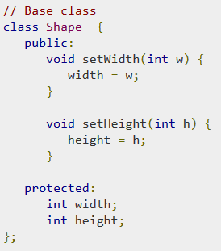
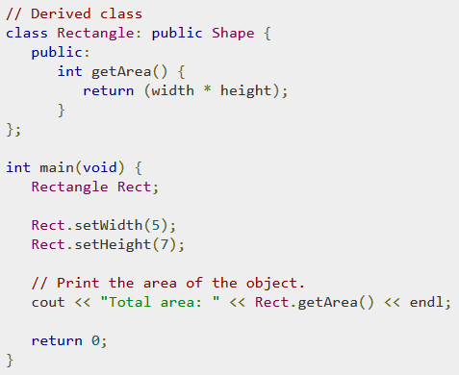
Inheritance Example protected

Slide 24
Public and Private inheritance
We have used public inheritance
class manager : public employee
Alternative is private inheritance
class manager : private employee
The keyword public specifies that objects of the derived class are able to access public member functions of the base class.
The keyword private specifies that objects of the derived class cannot access public member functions of the base class.

Slide 25
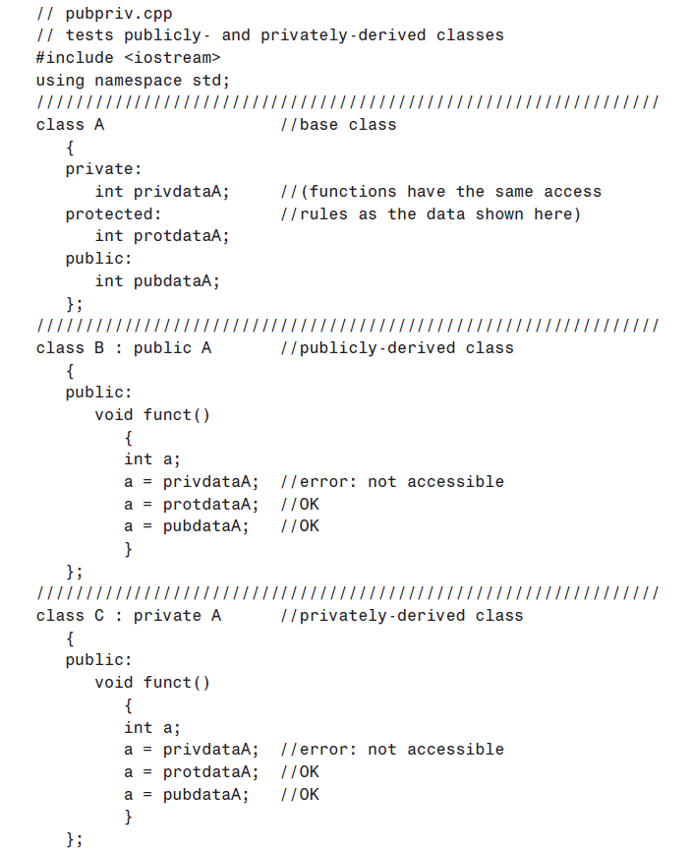

Slide 26

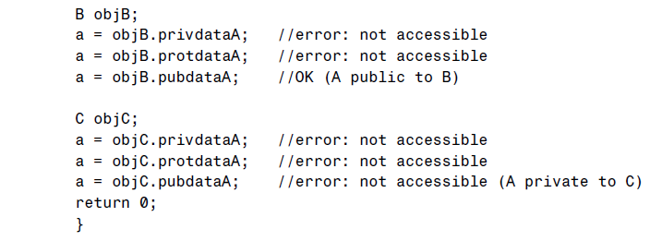

Slide 27
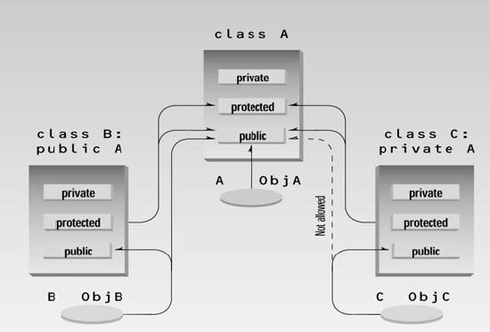

Slide 28
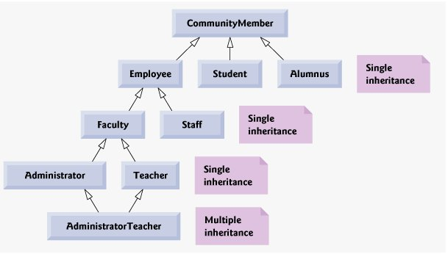
Inheritance hierarchy

